Slide 1
The Brain
Brain structure and functions
Part to play in CNS

Slide 2
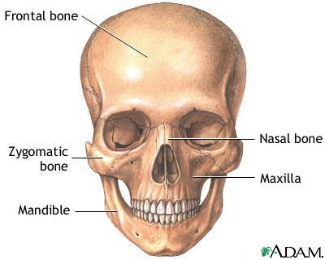
Brain protection
The skull is made up of 22 bones and encases the brain as a means of protection
18 cranial
14 facial bones

Slide 3
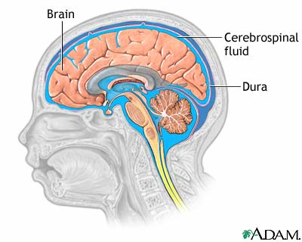
Brain protection
Cerebrospinal fluid is the fluid found in and around the CNS organs; the brain and spinal cord
It acts like a liquid cushion so they have buoyant protection in a situation of trauma

Slide 4
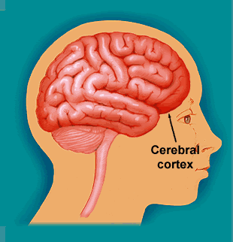
Cerebral hemispheres
You may already know; we have a left and right side of the brain…..
Right hemisphere
Left hemisphere
http://www.bbc.co.uk/science/humanbody/mind/interactives/personality/brain_sex/brainquiz.shtm
Male or female brain quiz !!

Slide 5
Cerebral cortex
The cerebral cortex is the biggest part of the brain, approximately two thirds of it.
It is the most highly developed part of the human brain and is responsible for thinking, perceiving, producing and understanding language.
Some areas deal with messages coming in from other senses. Others deal with outgoing messages

Slide 6
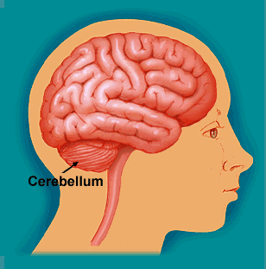
Cerebellum
Situated at the top of the spine, the cerebellum controls balance and muscle activity like fine motor skills

Slide 7
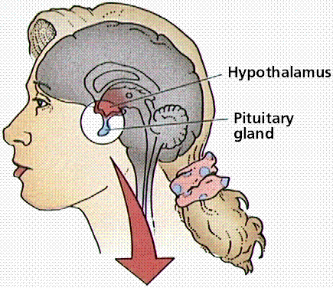
Pituitary gland
This regulates;
hunger and thirst,
body temperature
and hormones such as those which regulate the reproductive system..

Slide 8
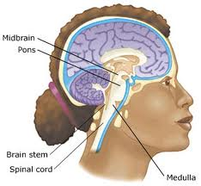
Medulla
Is at the top of the
brain stem and regulates functions
such as…
Heartbeat
Breathing
Blood pressure
Vomiting
Other vital functions

Slide 9
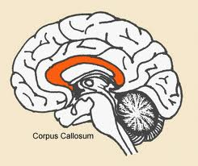
Corpus callosum
Connects the left and right side of the brain allowing communication between the two hemispheres as well as co-ordinating sensory movement such as eyes
Left
Right

Slide 10
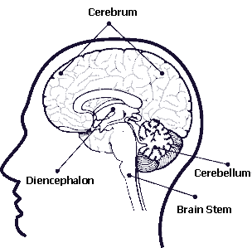
Colour, label and explain each function
________________
____________
_____________
________________
______________

Slide 11
Revision task:
Practice colouring in the different parts of the brain AND say what their function is.

